Slide 1
Web 2.0 vs 3.0
E-Commerce SE-413
Week 7

Slide 2
Web 2.0
Rich Content (Images, Video, 3D rendering)
Collaboration
Readable and Writable (Dynamic) Content
Can be User Generated

Slide 3
Web 2.0 – Social Networks
Enable Interactions.
Communities, group and relations
Information Sharing and Dissemination
Manage and Manipulate Influence

Slide 4
Web 2.0 – Collaborative Apps
Apps that allow creation and sharing of resources through teams or groups in a context.
Resource can be images, videos, documents etc.
Example: Wikipedia
Canva?
Fiverr?

Slide 5
Web 2.0 - Folksonomy
Collaborative tagging of information
Folks + Taxonomy = Folksonomy
Tags are not standardized i.e. Based on commonly used words
Make information searching easier
Social Bookmarking
Example:
Pinterest, Reddit, Del.icio.us

Slide 6
Web 2.0 – Media Sharing
Online Video Platforms
Specially built for creation, modification and sharing of multimedia content.
Upload, Convert, Edit, Store and Playback
User Generated (UGC) or Proprietary Content
On Demand or Live Streaming
Paid vs Free
YouTube vs YouTube Premium

Slide 7
Web 3.0
Decentralization
Entity ownership will be distributed
Security
Better and Stronger way of information storage and verification
Semantically Rich
Better experience through better understanding of information about entities.
Transparent
Understand context and provide experience according to context.

Slide 8
Web 3.0 - Blockchain
A shared, immutable ledger recording transactions and tracking assets in a business network
Participating miners validate transactions.
Multiple copies are sent to multiple miners
General verification is achieved through consensus
Proof of Work
Receive rewards for participation.

Slide 9
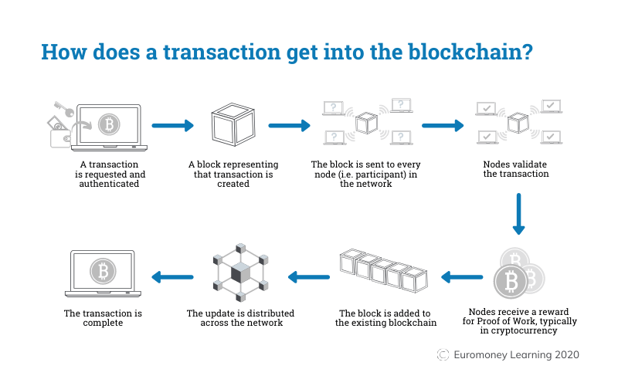
Web 3.0 - Blockchain

Slide 10
Web 3.0 - Blockchain
Ecommerce
Inventory Management
Tracking
Warranty Management

Slide 11
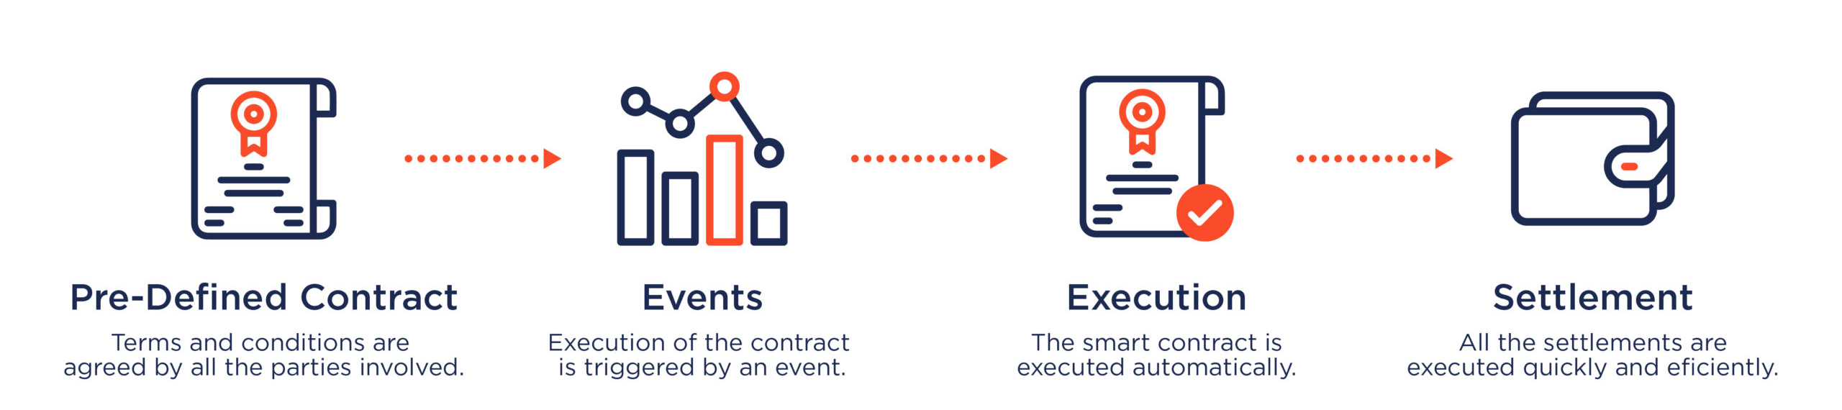
Web 3.0 – Smart Contracts
Self executing programs stored on Block chains
Oracle links real life events to smart contract executions
Contract is executed when conditions are met.

Slide 12
Web 3.0 – Smart Contracts
Ecommerce
DeFi
Borrowing, Trading etc.

Slide 13
Web 3.0 – Semantic Web
Provide context and further information (meta data) about entities to computers and devices.
Allows them to make meaningful interpretation
Enables better experiences.
Examples: Searches are better suited to you.
Google Knows who you are.
RDF is one of the standard for describing metadata

Slide 14
Web 3.0 – Semantic Web
E-Commerce:
Better understanding of customer based on life behavior outside of shopping experience.

Slide 15
Web 3.0 – Ubiquitous Computing
Ubiquitous = Present Everywhere
Enable device to connect and coordinate with each other for seamless experience
Enable more devices coordination with Ubiquitous Web.
Dynamic adaption of user preferences.
Network agnostic Internet Services.
Automatic selection of settings based on user. (Ambient AI)

Slide 16
Web 3.0 – Ubiquitous Computing
E-Commerce:
Purchasing experience available anywhere on any device.

Slide 17
Web 3.0 IoT
Internet of Things
An Architecture Enables sensors and devices to connect with each other and exchange information.
May be Intelligent. May even involves AI.
Example:
Smart appliances connected to the internet.
Wearables, Smart TVs, Circadia HMS
Amazon Dash Button

Slide 18
Web 3.0
Trustless and Permission less
Immersive
Distributed

